Slide 1

Predicting Coupon Acceptance on E-commerce Platforms - by Yamini Nurukurthi

Slide 2
Problem Statement:
The goal of this project is to leverage machine learning techniques to analyze driving scenarios and user attributes collected from an e-commerce website. By accurately predicting whether users will accept coupons during their journeys, the aim is to optimize coupon distribution strategies and enhance user engagement with the platform's offerings.
The survey describes different driving scenarios including the user’s destination, current time, weather, passenger, coupon attributes, user attributes, and contextual attributes, and then asks the user whether he/she will accept the coupon or not.

Slide 3
Steps followed for the Model Development
Understanding the problem statement
The task is to predict how many coupons the customer will receive through different visits to CoffeHouse, Bar, Restaurant(<20),Restaurant(20-50),carry out and Takeaway.
Here the target Variable is binary class Accept(Y/N?) 0 - not accept coupon and 1- accept coupon.
The Problem has target variable and needs prediction of either classes, Hence the problem is a supervised, classification task.
Data Preprocessing
Exploratory Data Analysis
Model Development
Model Performance metrics and Evaluation

Slide 4
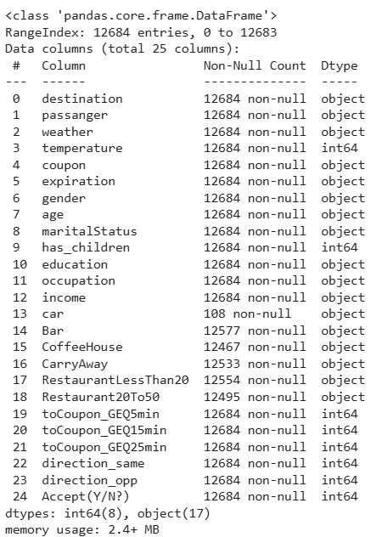
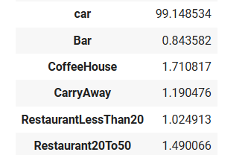
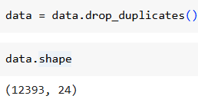
Data Preprocessing:
Data gathering:
The data set has been provided as input in CSV format.
The initial steps involve importing the necessary package in the python.
Data Cleaning:
Handling Missing values: data.isnull().sum()
Hence the car variable missing data is more than 25% , we can remove the variable.
The variable ‘Bar’,’CoffeeHouse’,’CarryAway’,’RestaurantLessThan20’,’Restaturant20To50’ is less than 25% , we can impute with mode as they are categorical variables.
Drop the duplicated values
data.shape – (12684,24)
Duplicated data – 291
Missing data

Slide 5
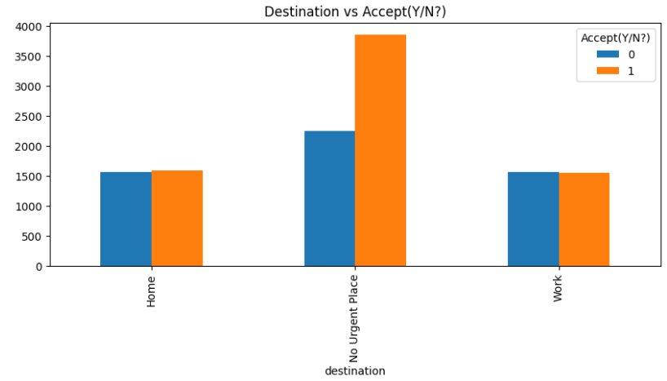
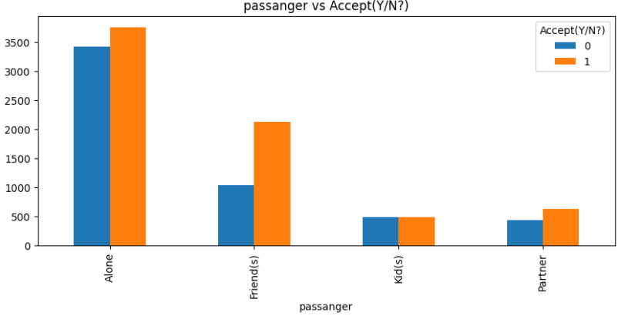
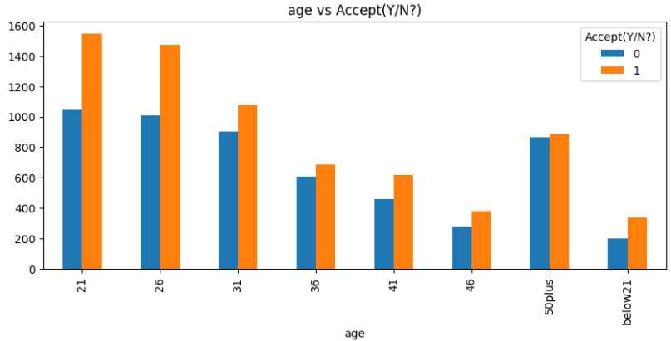
Exploratory Data Analysis:
It’s used to understand and compare the data whether it’s a raw data without any assumptions being made and also to summarize and describe the characteristics of the dataset using statistical and visualization approach.
Coupon acceptance rate is more with passengers are travelling alone.
-3865 customers with 63% of acceptance rate who are travelling else where apart from Home and work have accepted coupons.
Most of the customers are in age limit of 21-26 with 59% of acceptance rate, below 21 age have the acceptance rate of 63%.

Slide 6
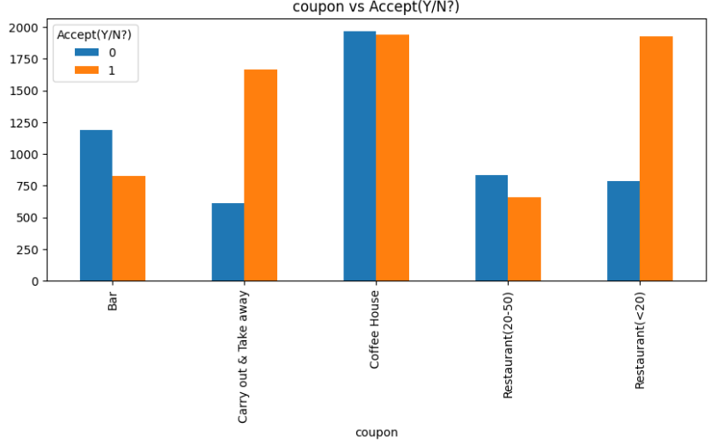
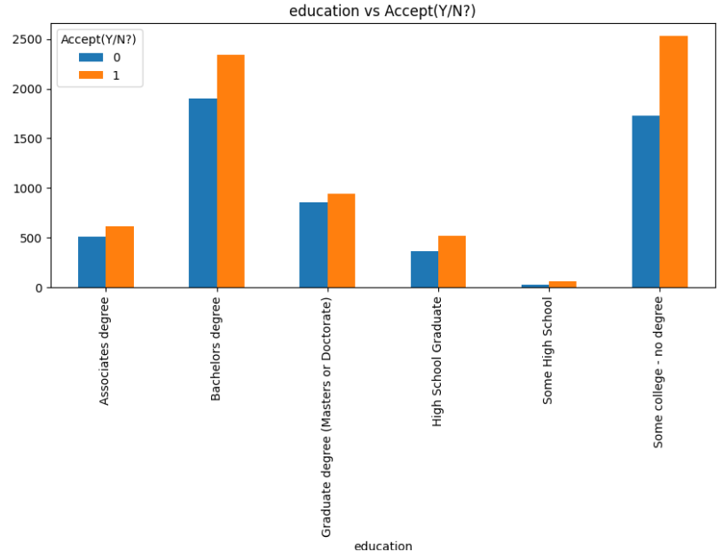
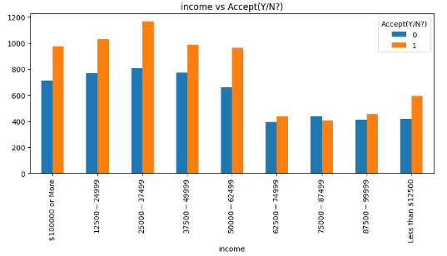
Exploratory Data Analysis:
Most of the customers accepted the coupons from carryout and Takeaway with 73% and second most acceptance rate of 71% with restaurant(<20) but most coupons are given by coffee House and Restaurant(<20).
Highest acceptance rate of 71% is for high school and all other education degree acceptance rate is similar.
- Customers with the salary range of $25000-$37499 with accepted rate of 59%
- Income beyond 62500 have similar accept and rejection rates on coupons.

Slide 7
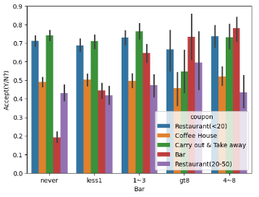
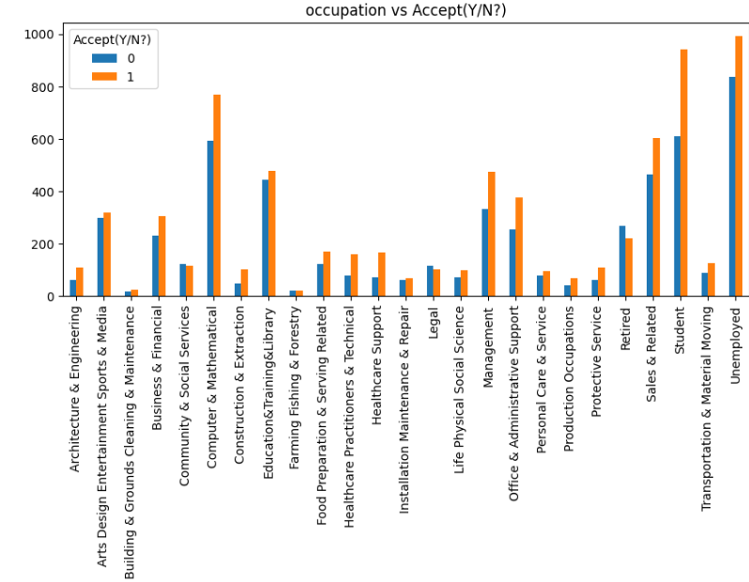
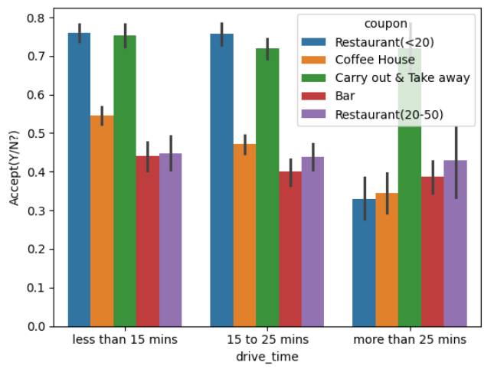
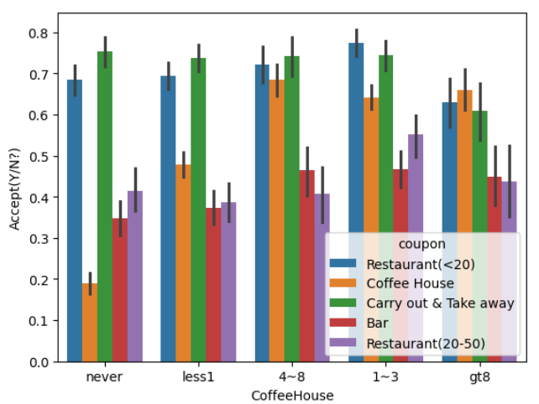
Exploratory Data Analysis:
-Customers who go 4-8 times and more 8 times are accepting more coupons from bar.
-Customers never receive coupons from bar receive from carryout and restaurant<20.
- Coupon acceptance rate of 70% which is highest customers are from Healthcare sector, most no of coupons have by unemployed.
-Most coupon type within 15mins drive are restaurant type.
-Most of the coupons issued with driving distance less than 15 min and acceptance rate is also more with 61%.
-Customers who visited 4-8 times or greater than 8 times have more coupons of coffeehouse.
-Most customers accept carryout and takeaway coupons than any other.

Slide 8
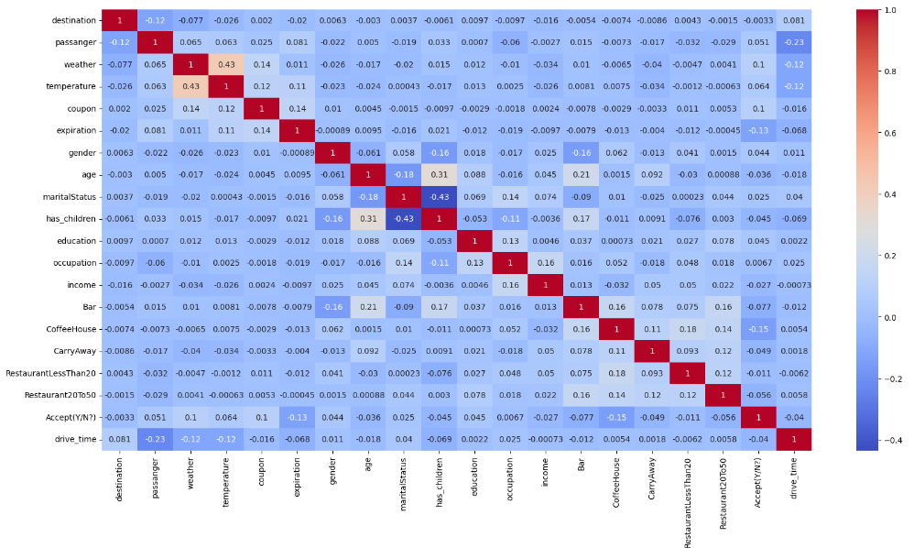
Correlation Matrix Heat Map:
Since the correlation values of direction_same and direction_opp is negative with -1,we can drop those columns.
We can see that there is no strong relation between the variable martialstatus and has_children with correlation coefficient of 0.43.
Hence we need to remove features 'martialstatus' and 'has_children’ from dataframe.

Slide 9
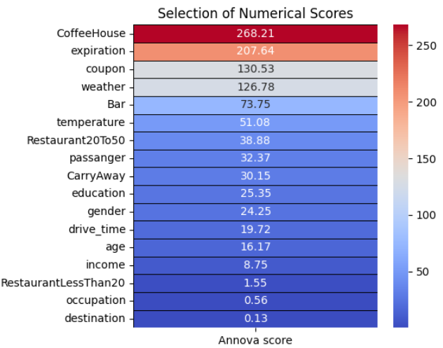
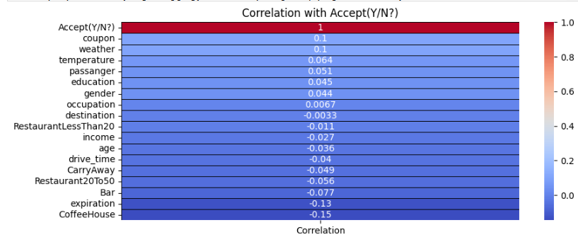
Correlation and Annova Score:
Here coupon, weather variables are highly significant and have strong relationship with target variable.
Target variable is inversely proportional to coffeehouse and expiration variables.

Slide 10
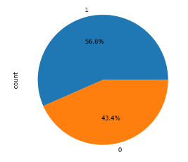
Data Preprocessing:
Label Encoding:
Since the machine should be inputted with the binary format, all categorical variables need to be converted to binary format.
This can be done with the help of Label Encoder.
Data Split:
The data will be split into two data frames.
X = Data frame of independent variable.
Y = Data frame of target variable.
Feature Scaling:
For Distance based ML algorithms, feature scaling is important.
This is because the distance between 2 points and their dependent features should be compared by scale.
For this project a standard scaler() has been used.
Imbalance Data Check: we have balance data.
Target variable - Accept(Y/N)

Slide 11
MODEL BUILDING:
Train Test Split:
The data set is split into training data and testing data at ratio of 75% training data and 25% as the test data.
Model Trained:
Different Machine Learning models has been applied and their respective accuracy has been calculated.
As the data is Classification problem so we have applied supervised machine learning algorithm.
Logistic Regression
Decision Tree Classifier
Random Forest Classifier
Gradient Boosting Classifier
XG Boosting Classifier
Support Vector Machine
Navie Bayes Classifier
Evaluation and Performance Metrics:
Accuracy
Classification Report
Confusion Matrix

Slide 12
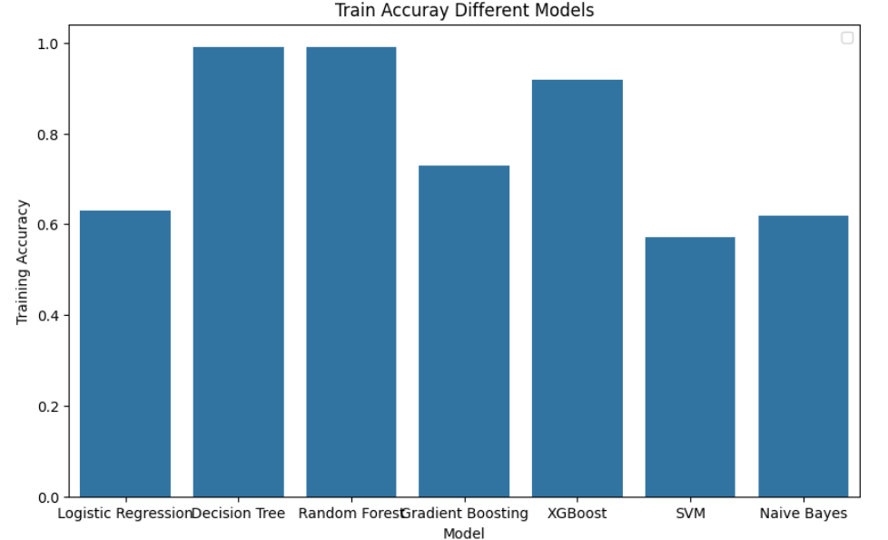
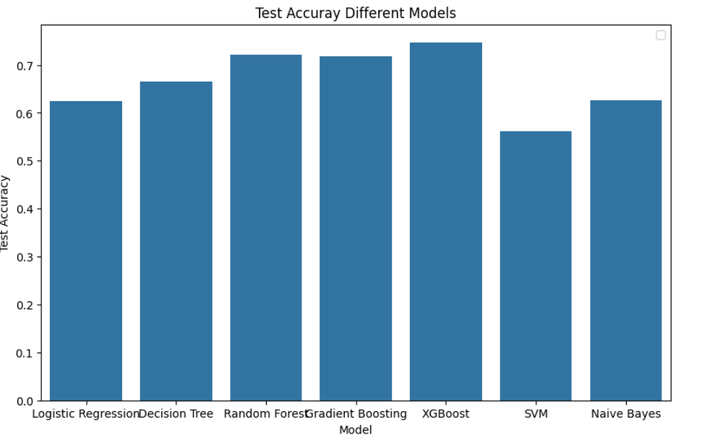
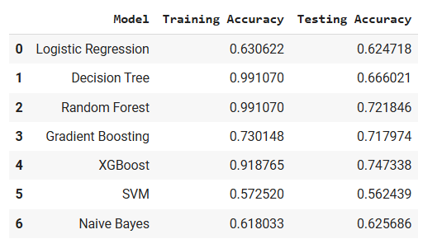
Train and Test Accuracy of different models:
From the tabular data,
Some models leads to overfitting.
we can see that Gradient Boosting giving good result.

Slide 13
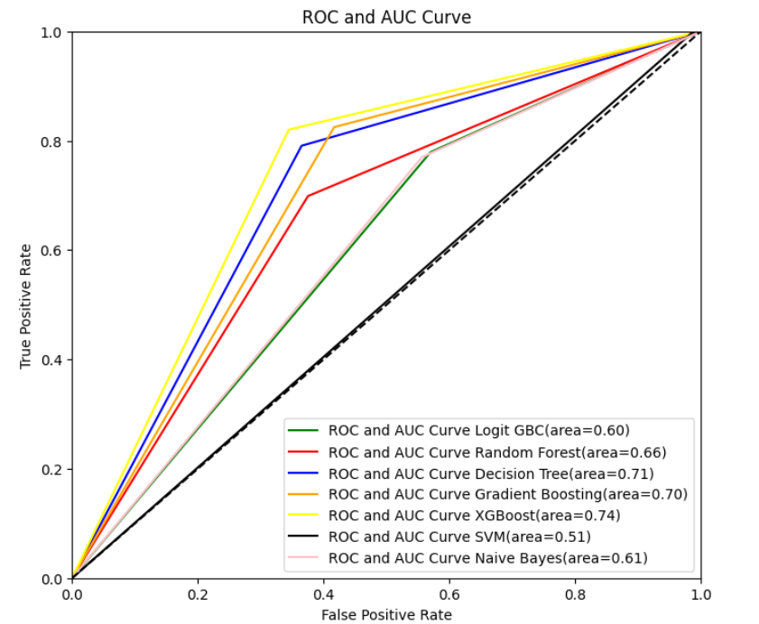
ROC-AUC FOR VARIOUS MODELS:
ROC and AUC Score is good for models XG Boost, Gradient Boosting and Decision Tree.

Slide 14
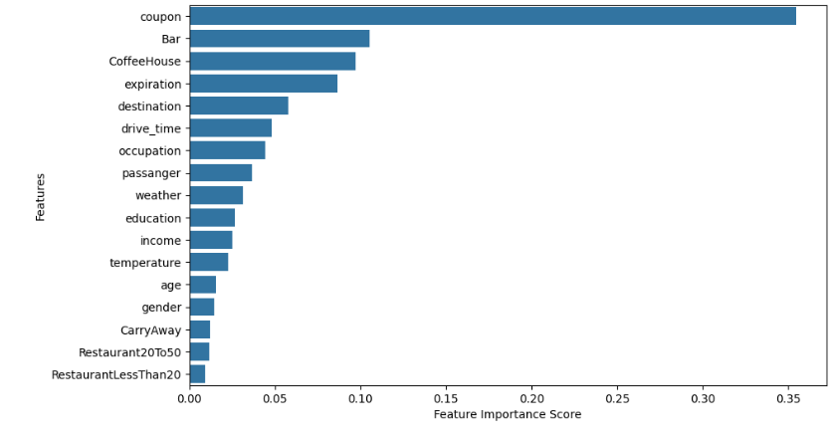
Feature Importance:
We can observe that below features determine whether customer accept the coupon or not.
Coupon
Bar
CoffeeHouse
Expiration
Destination
Drive_time
Occupation

Slide 15
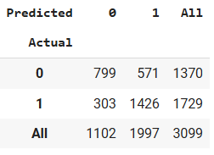
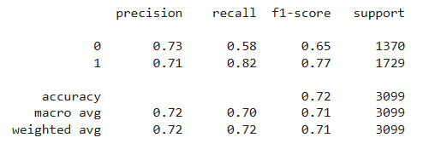
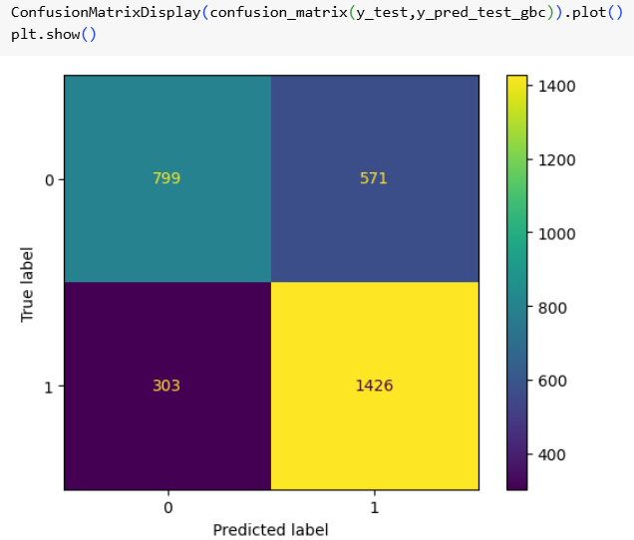
Gradient Boosting Results:
Out of all 6 Models, Gradient Boosting can be chosen since it has good results when compare to others terms of all evaluation metrics.
Accuracy Score:
Training Accuracy : 0.7301484828921885
Testing Accuracy : 0.717973539851565
Classification Report:
Performance metrics:
Customer who did not use coupons in actual are 1370.
Customer who did use coupons in actual are 1729.
Predicted customers who did not use coupons are 1102.
Predicted customers who use coupons are 1997.

Slide 16
THANK YOU

